Slide 1



TUBES PBO

Slide 2



Rebah.an tech (RA-10)
LEADER:
Ahmad Fadillah
120140092
Anisa Prasetya
120140087
Rahman Pajri
120140118
William Rusli
120140090
Alfian Kafilah
120140109
M. Fikri Damar
120140077

Slide 3




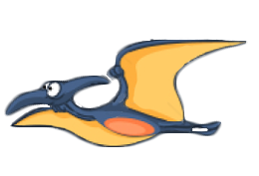

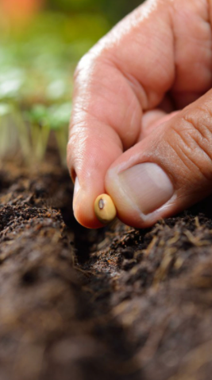





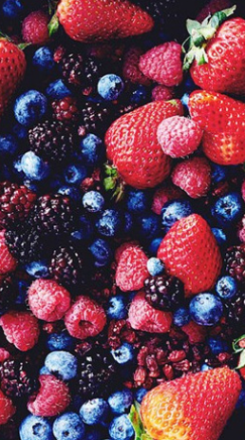
MORPHLING
rebah.an tech
Kelompok PBO10-RA
baru
fruits
seed
soya
tree
lama
rapper
bunga

Slide 4
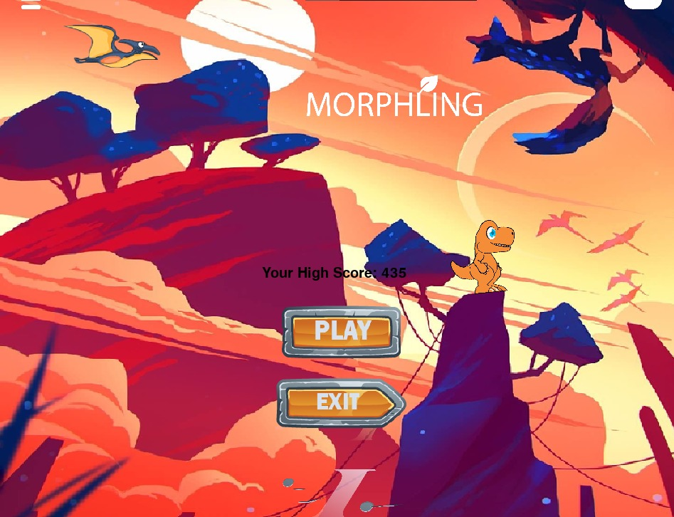

FOREST
07
design by hmpt
Demo Aplikasi Versi Alpha
Berikut adalah tampilan menu utama pada game morphling
yang telah dibuat. Terdapat 2 menu yaitu Play dan exit
rebah.an tech
Kelompok PBO10-RA
about seed
A seed is an embryonic plant enclosed in a protective outer covering. The formation of the seed is part of the process of reproduction in seed plants, the spermatophytes, including the gymnosperm and angiosperm plants.
Seeds are the product of the ripened ovule, after fertilization by pollen and some growth within the mother plant. The embryo develops from the zygote, and the seed coat from the integuments of the ovule.
design by hmpt

Slide 5


FOREST
07
design by hmpt
Demo Aplikasi Versi Alpha
Ketika user meng-klik tombol
Play, maka akan tampil halaman baru untuk memilih karakter yang diinginkan
Ketika user meng-klik tombol
Exit, maka game akan berakhir (keluar game)
rebah.an tech
Kelompok PBO10-RA
about seed
A seed is an embryonic plant enclosed in a protective outer covering. The formation of the seed is part of the process of reproduction in seed plants, the spermatophytes, including the gymnosperm and angiosperm plants.
Seeds are the product of the ripened ovule, after fertilization by pollen and some growth within the mother plant. The embryo develops from the zygote, and the seed coat from the integuments of the ovule.
design by hmpt

Slide 6


FOREST
07
design by hmpt
Demo Aplikasi Versi Alpha
Memilih Karakter
User dapat memilih karakter mana yang ingin dimainkan. Masing masing karakter memiliki tema dan obstacle yang berbeda-beda.
rebah.an tech
Kelompok PBO10-RA
about seed
A seed is an embryonic plant enclosed in a protective outer covering. The formation of the seed is part of the process of reproduction in seed plants, the spermatophytes, including the gymnosperm and angiosperm plants.
Seeds are the product of the ripened ovule, after fertilization by pollen and some growth within the mother plant. The embryo develops from the zygote, and the seed coat from the integuments of the ovule.
design by hmpt

Slide 7


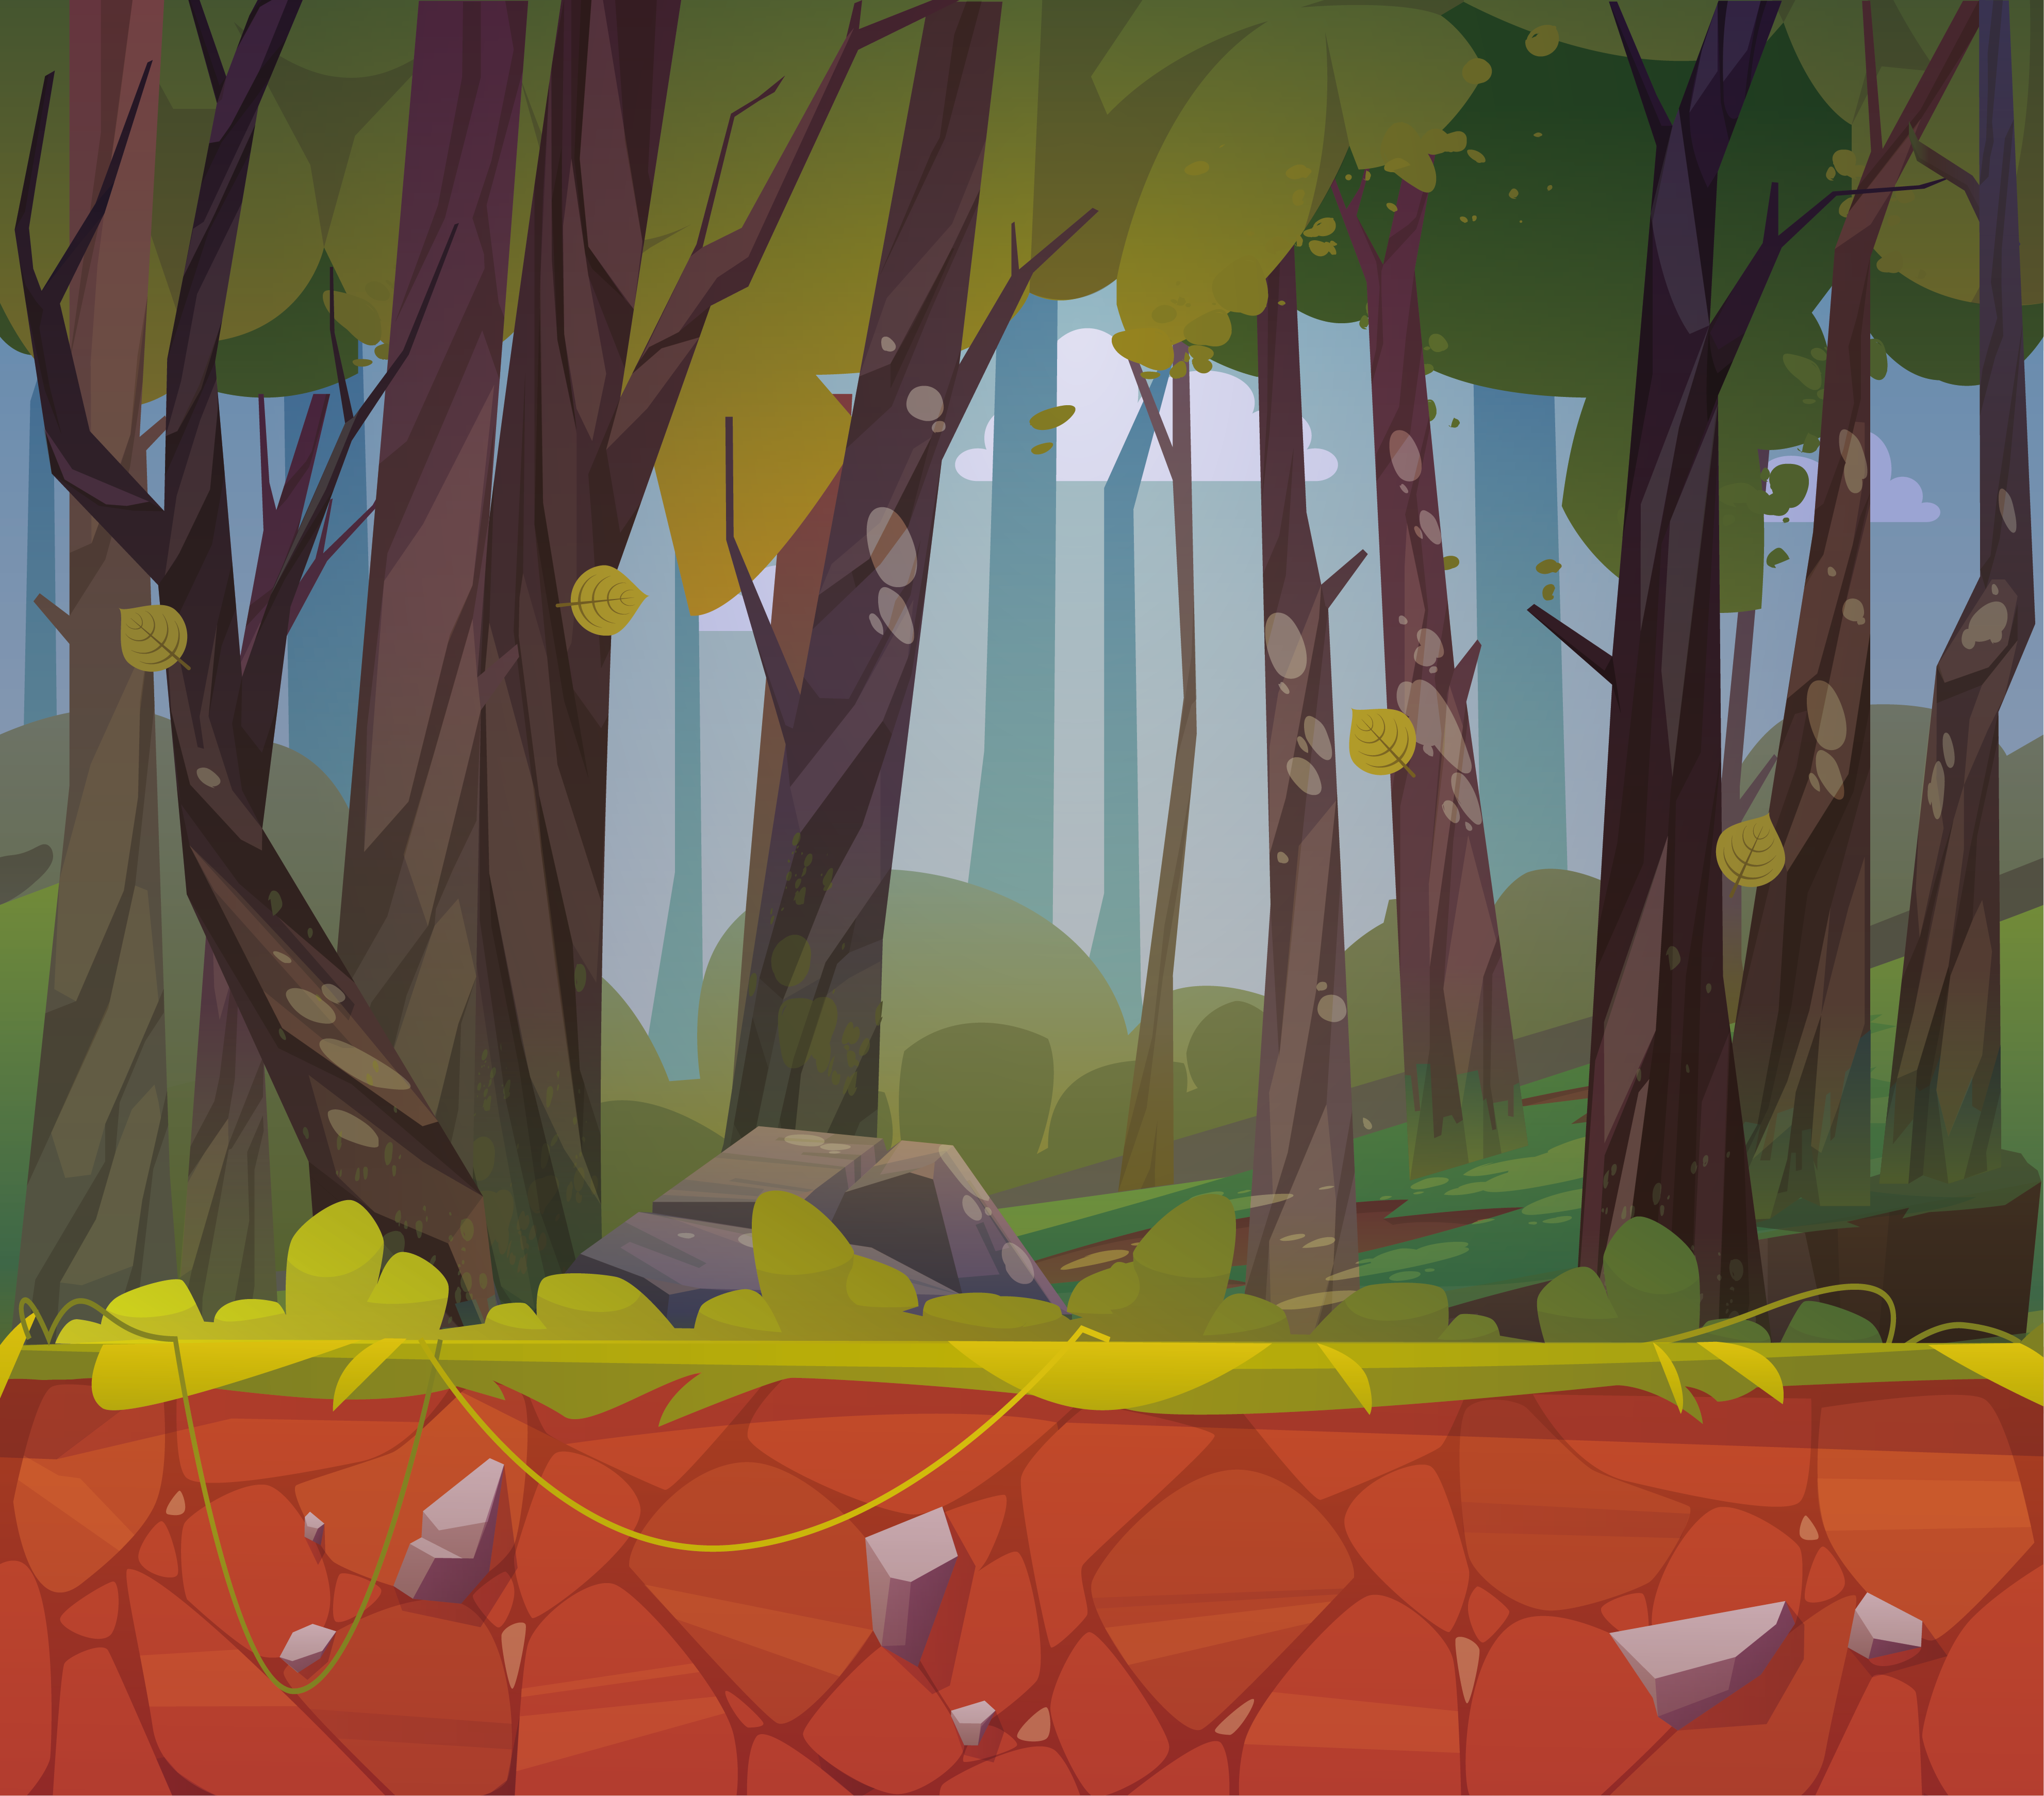
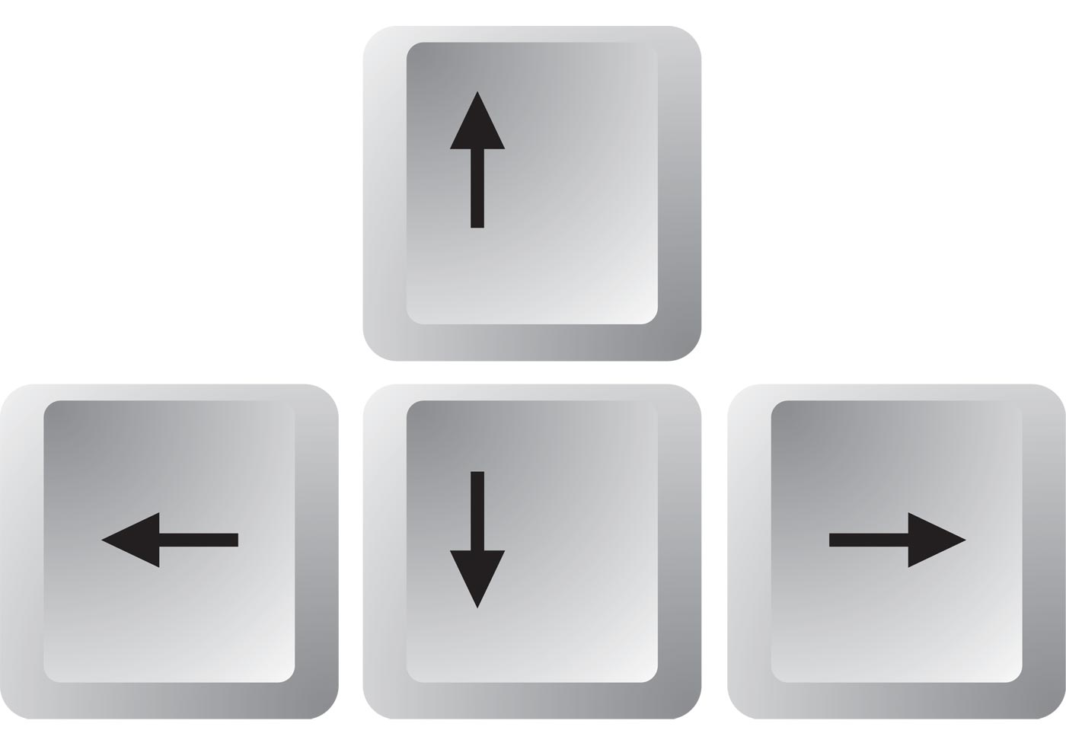
FOREST
07
design by hmpt
Demo Aplikasi Versi Alpha
Ketika user menekan tombol
Up, maka dino akan lompat
Ketika user menekan tombol
down, maka dino akan menunduk
Ketika memilih karakter Dino, maka user otomatis akan Memulai game dengan tampilan seperti gambar dibawah.
User meng-klik tombol up/down ketika
Ingin melewati berbagai obstacle
rebah.an tech
Kelompok PBO10-RA
about seed
A seed is an embryonic plant enclosed in a protective outer covering. The formation of the seed is part of the process of reproduction in seed plants, the spermatophytes, including the gymnosperm and angiosperm plants.
Seeds are the product of the ripened ovule, after fertilization by pollen and some growth within the mother plant. The embryo develops from the zygote, and the seed coat from the integuments of the ovule.
design by hmpt

Slide 8



FOREST
07
design by hmpt
Demo Aplikasi Versi Alpha
Berikut ini adalah obstacle yang tersedia Ketika user memilih karakter dino. Obstacle akan ditampilkan secara random.
Krystal
lovebird
Kaktus
rebah.an tech
Kelompok PBO10-RA
about seed
A seed is an embryonic plant enclosed in a protective outer covering. The formation of the seed is part of the process of reproduction in seed plants, the spermatophytes, including the gymnosperm and angiosperm plants.
Seeds are the product of the ripened ovule, after fertilization by pollen and some growth within the mother plant. The embryo develops from the zygote, and the seed coat from the integuments of the ovule.
design by hmpt

Slide 9
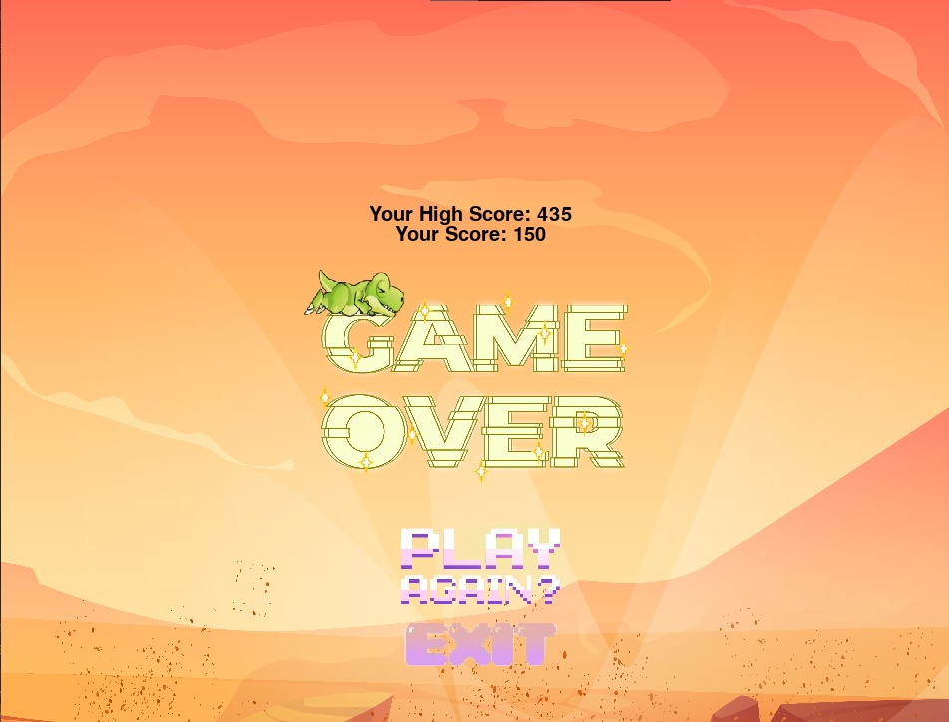
FOREST
07
design by hmpt
Demo Aplikasi Versi Alpha
Di sinilah tantangan memainkan Morphling. Membuat karakter dino melewati semua osbtacle adalah hal yang sangat sulit. Selain obstacle yang beragam, kecepatan dino akan semakin bertambah seiring berjalannya waktu. Jika user tidak tepat Ketika melewati obstacle, maka karakter dino akan menabrak obstacle. Dan, user harus mengulang game ini dari awal.
Gambar disamping adalah tampilan game over pada karakter dino beserta score yang tercapai.
rebah.an tech
Kelompok PBO10-RA
about seed
A seed is an embryonic plant enclosed in a protective outer covering. The formation of the seed is part of the process of reproduction in seed plants, the spermatophytes, including the gymnosperm and angiosperm plants.
Seeds are the product of the ripened ovule, after fertilization by pollen and some growth within the mother plant. The embryo develops from the zygote, and the seed coat from the integuments of the ovule.
design by hmpt

Slide 10


FOREST
07
design by hmpt
Demo Aplikasi Versi Alpha
Klik tombol Play Again jika user ingin bermain kembali
Klik tombol Exit jika user ingin keluar
rebah.an tech
Kelompok PBO10-RA
about seed
A seed is an embryonic plant enclosed in a protective outer covering. The formation of the seed is part of the process of reproduction in seed plants, the spermatophytes, including the gymnosperm and angiosperm plants.
Seeds are the product of the ripened ovule, after fertilization by pollen and some growth within the mother plant. The embryo develops from the zygote, and the seed coat from the integuments of the ovule.
design by hmpt

Slide 11

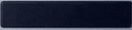
FOREST
07
design by hmpt
Demo Aplikasi Versi Alpha
Ketika memilih karakter Ptero, maka user otomatis akan Memulai game dengan tampilan seperti gambar dibawah.
User menekan tombol space Ketika
Mengendalikan karakter ptero
Melewati obstacle
rebah.an tech
Kelompok PBO10-RA
about seed
A seed is an embryonic plant enclosed in a protective outer covering. The formation of the seed is part of the process of reproduction in seed plants, the spermatophytes, including the gymnosperm and angiosperm plants.
Seeds are the product of the ripened ovule, after fertilization by pollen and some growth within the mother plant. The embryo develops from the zygote, and the seed coat from the integuments of the ovule.
design by hmpt

Slide 12



FOREST
07
design by hmpt
Demo Aplikasi Versi Alpha
Berikut ini adalah obstacle yang tersedia Ketika user memilih karakter ptero. Obstacle akan ditampilkan secara random.
Pipa
rebah.an tech
Kelompok PBO10-RA
about seed
A seed is an embryonic plant enclosed in a protective outer covering. The formation of the seed is part of the process of reproduction in seed plants, the spermatophytes, including the gymnosperm and angiosperm plants.
Seeds are the product of the ripened ovule, after fertilization by pollen and some growth within the mother plant. The embryo develops from the zygote, and the seed coat from the integuments of the ovule.
design by hmpt

Slide 13

FOREST
07
design by hmpt
Demo Aplikasi Versi Alpha
Sama seperti karakter dino sebelumnya, Jika user tidak tepat Ketika melewati obstacle, maka karakter ptero akan menabrak obstacle. Dan, user harus mengulang game ini dari awal.
Gambar disamping adalah tampilan game over pada karakter ptero beserta score yang dicapai.
rebah.an tech
Kelompok PBO10-RA
about seed
A seed is an embryonic plant enclosed in a protective outer covering. The formation of the seed is part of the process of reproduction in seed plants, the spermatophytes, including the gymnosperm and angiosperm plants.
Seeds are the product of the ripened ovule, after fertilization by pollen and some growth within the mother plant. The embryo develops from the zygote, and the seed coat from the integuments of the ovule.
design by hmpt

Slide 14
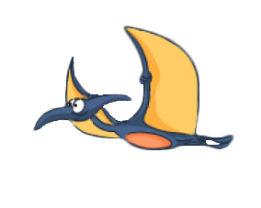
FOREST
07
design by hmpt
Kesimpulan
Dari demo game versi alpha yang telah dipresentasikan dapat ditarik kesimpulan sudah hampir 100% game morphling selesai dibuat. Dengan berhasil dibuatnya game morphling, diharapkan bisa menjadi alternative bermain game ketika jenuh. Kelebihan yang ditawarkan pada game ini yaitu obstacle menantang, tombol yang digunakan untuk bermain sedikit, cara bermain game yang sederhana dan gratis.
Game morphling mengajarkan para pemainnya arti untuk lebih sabar dalam menghadapi sesuatu. Kegagalan demi kegagalan pasti akan membuat orang menjadi kesal dan stress, namun dengan keahlian dan usaha terus menerus pasti akan membuahkan hasil yang diinginkan.
rebah.an tech
https://github.com/AhmadFadillah12/Rebah.an-tech
Kelompok PBO10-RA
about seed
A seed is an embryonic plant enclosed in a protective outer covering. The formation of the seed is part of the process of reproduction in seed plants, the spermatophytes, including the gymnosperm and angiosperm plants.
Seeds are the product of the ripened ovule, after fertilization by pollen and some growth within the mother plant. The embryo develops from the zygote, and the seed coat from the integuments of the ovule.
design by hmpt

Slide 15

morphling
rebah.an tech
Kelompok PBO 10-RA

Slide 16
Kasih
Terima
Morphling

